Slide 1


2. Control and pattern matching
Mrinal Vashisth
PhD Year 2, Computational Psychometrics, TSU, RF
M.Sc. Human Development: Genetics, Neuroscience and Psychology, TSU, RF
M.S. Applied Mathematics and Information Technology (Systems Biology and Bioinformatics), ITMO, RF
B.Tech. Biotechnology, JNU, RI

Slide 2
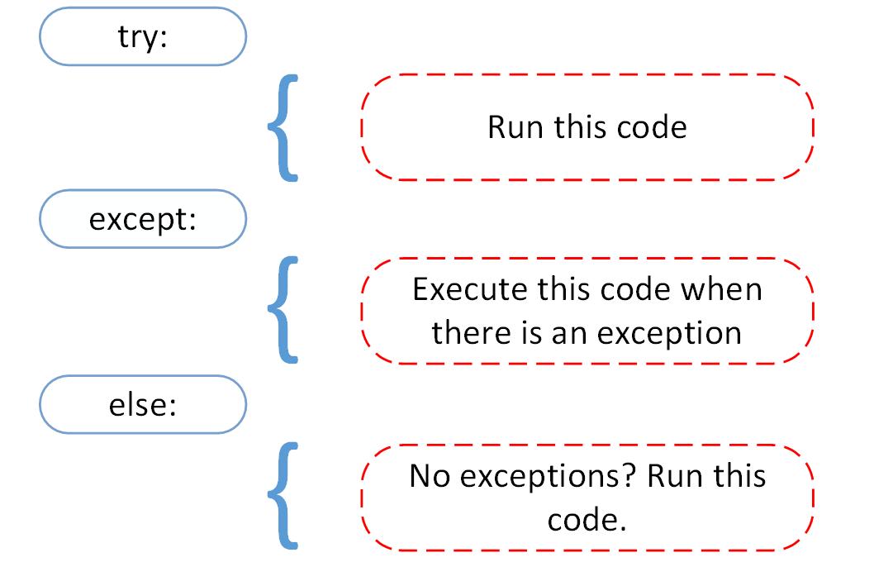
Try, except, assert
assert variable type
if type(x) == True:
execute code
else:
raise Error

Slide 3
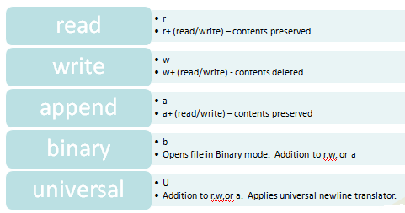
File opening modes in python
file.open(path, ‘read_mode’)
do something
file.close()

Slide 4
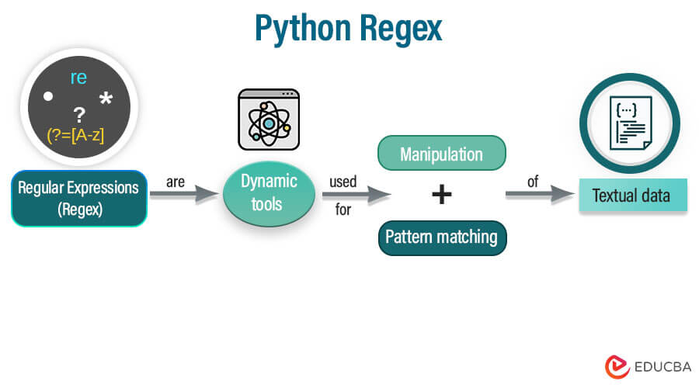
What to do after file is open?
perform computation
search for strings and patterns
REGEX!
https://www.educba.com/python-regex/
We will go through this document at the end of the lecture! You can also search for regex cheatsheets!

Slide 5
Assignment 3 Option 1
Create a list, dictionary by generating random numbers
Now make a list and a dataframe
Then create dataframes from these lists
Iterate over this dataframe row by row
Time the program (you can use jupyter cell-magic function called %%time or just give the output of python file execution in console)
Finally, make a note, that never iterate row-wise over dataframes.

Slide 6
Assignment 3 Option 2
Open the random.txt file
Find the excluded line and print it
Find all numbers in the document using regex.
Write this obtained list to a file
Close it.

